Slide 1
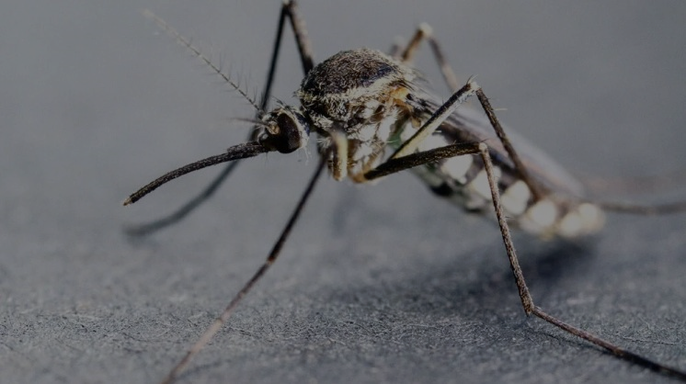
Malaria death cases in western African
BY CHIZARAM

Slide 2
Table of content
INTRODUCTION
RESEARCH PROBLEM
RESEARCH QUESTION
DATA CLEANING
VISUALIZATION
CONCLUSION

Slide 3
INTRODUCTION
The tropical climates in many Western African countries provides an environment conducive to the transmission of malaria. This dataset from 2015-2019 focus on the death of Female in western African countries between the age of 15-49years

Slide 4
RESEARCH PROBLEM
“There are more people dying of malaria than any specific cancer” Bill Gates.
West African malaria female death cases from 2015-2019. Human capital is what grows a state, how have this death affected our population or rather how will it affect our population
These countries have a tropical climate so eradicating malaria will take intentional steps but even with the steps taken malaria is spiking high, leading to more death cases everyday.

Slide 5
RESEARCH QUESTIONS
West African Countries total population from 2015-2019.
Total malaria death cases for female in West African Countries from 2015-2019
Year with the highest death case.
Year with the less case
Is West African human capital still standing

Slide 6
DATA CLEANING.
I used both EXCEL, Python and Sql for my data cleaning,

Slide 7
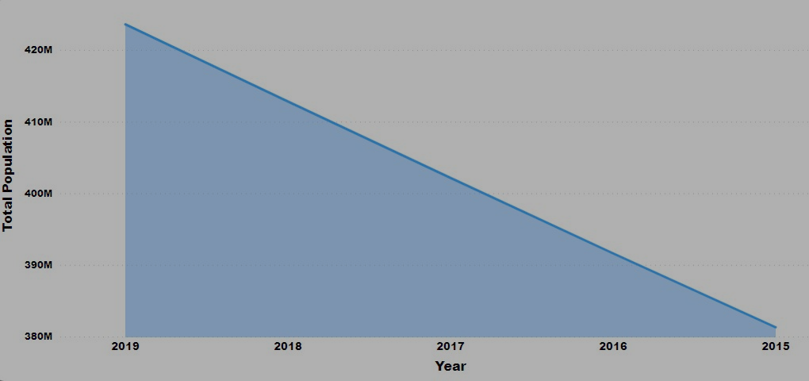
This analysis shows the population of West African countries from 2015 – 2019. Each year there is an increase in population eve with frequent malaria death cases in each year
POPULATION

Slide 8
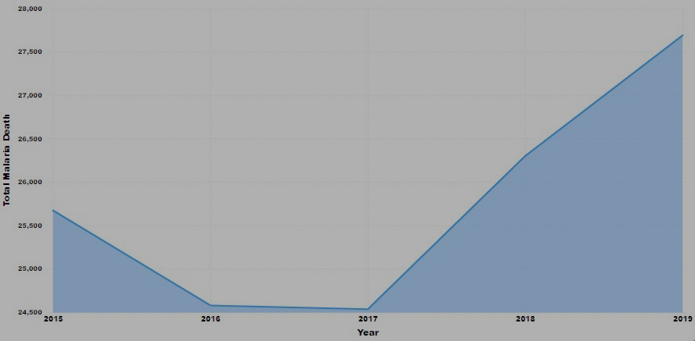
The analysis show that 2019 had the highest malaria death case. UNICEF and other organization in their malaria article state that covid 19 was the cause of the increase. It is surprising that total malaria death cases is lower in 2017. More research should be carried out on why.
TOTAL MALARIA DEATH CASES BY YEAR

Slide 9
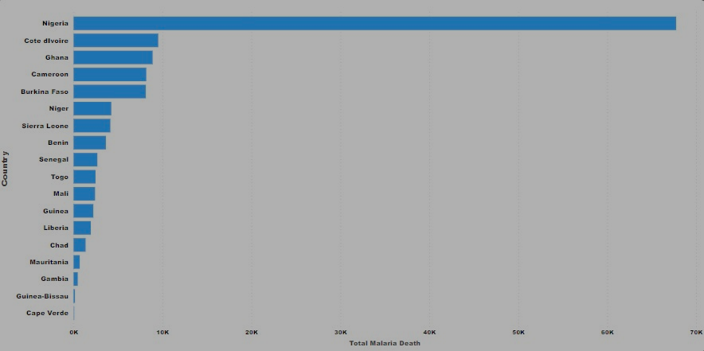
From this analysis, out of 14 West African countries, it can be see that Nigeria have the highest number(67739) of death malaria cases with a 58857 gap from the second highest country which is Ghana with 8882.
TOTAL MALARIA DEATH CASES BY COUNTRY

Slide 10
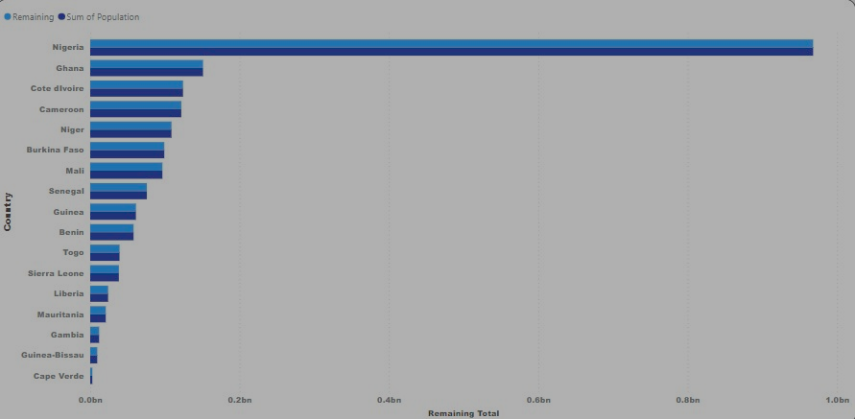
REMAINING POPULATION
From the analysis, it can be seen that Nigeria even with high death malaria cases from 2016-2019 still have a high population.

Slide 11
CONCLUSION
CONCLUSION
More investigation should be done to know what reduced death cases in 2017
People in western African should be educated on malaria
If possible, more foreign aids will greatly benefit these countries.
Intentional measures like good health infrastructure and transportation to both the rural and urban areas should be encouraged by government and the citizens.

